Slide 1
Evolutionary Architecture（演进式架构）
QCon：“进化论告诉我们，当环境持续变化的时候，唯有不断调整自己以适应新环境的生物方能生存下去”

Slide 2
Why Enterprise Architecture Need Evolution
Business makes technology need progress
Technology itself needs progress

Slide 3
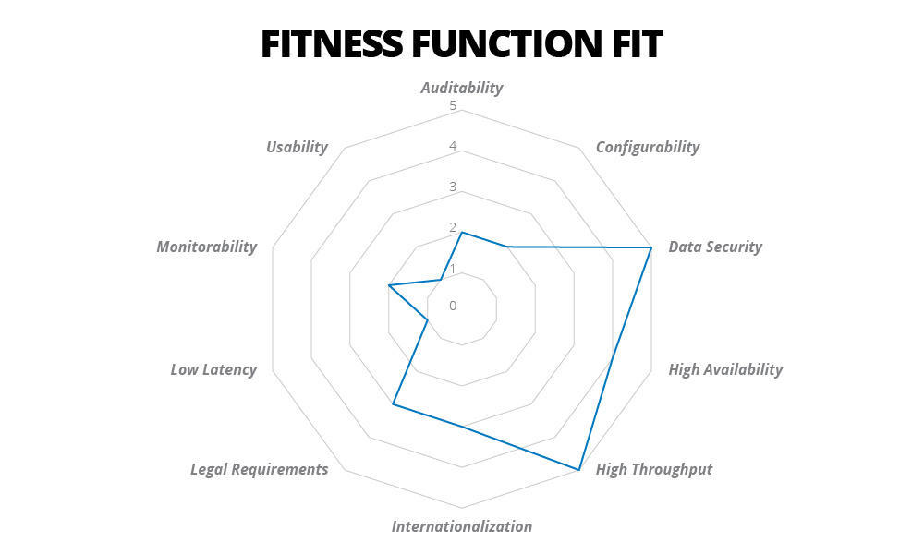
How Architecture Evolution
Conway’s law: Organizations which design systems are constrained to produce designs which are copies of the communication structures of these organizations. - Melvin Conway(1967)
Enterprise architecture needs to meet the characteristics of enterprise business and environment
（业务形态决定了技术架构的演进）

Slide 4
How Architecture Evolution
Enterprise system architecture can not be achieved in one step
Identify business features
Stage problem？
Stage target？
Stage architecture principles?

Slide 5
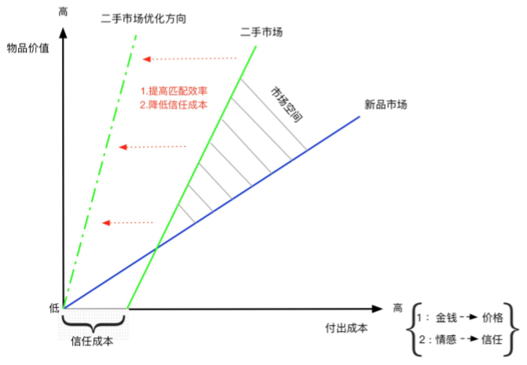
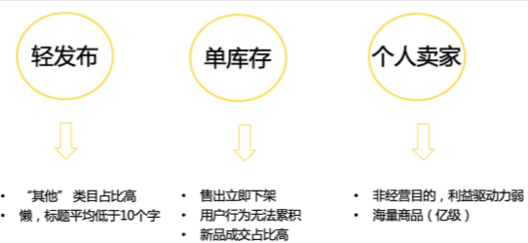
How Architecture Evolution (咸鱼Example)
Identify business features

Slide 6
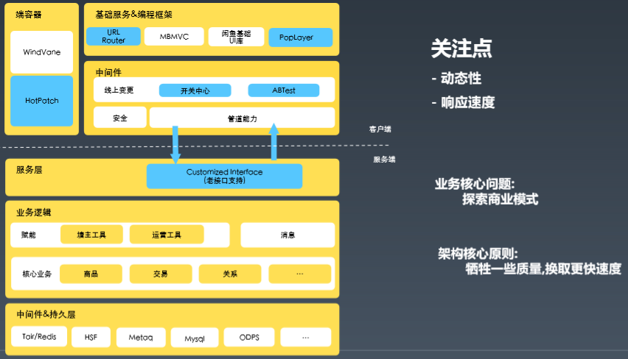
How Architecture Evolution (咸鱼Example)
State 01：“试错阶段”

Slide 7
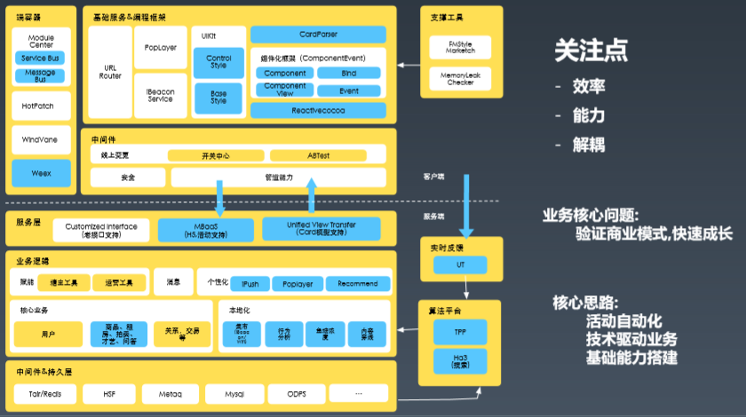
How Architecture Evolution (咸鱼Example)
State 02：“发展阶段”

Slide 8
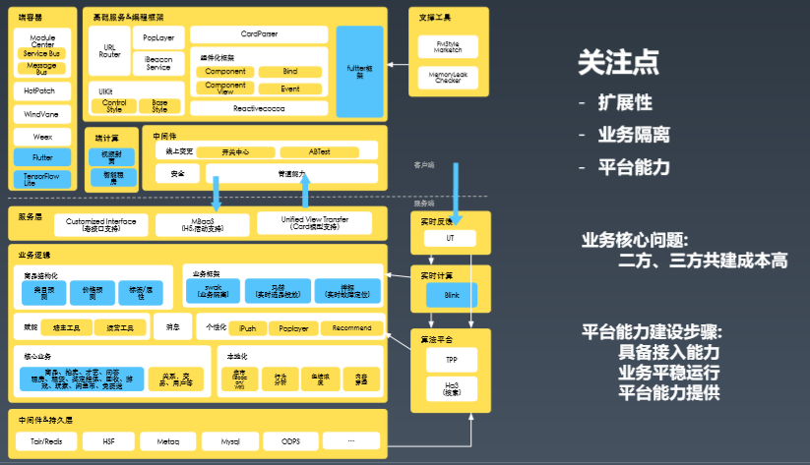

How Architecture Evolution (咸鱼Example)
State 03：“平台阶段”

Slide 9
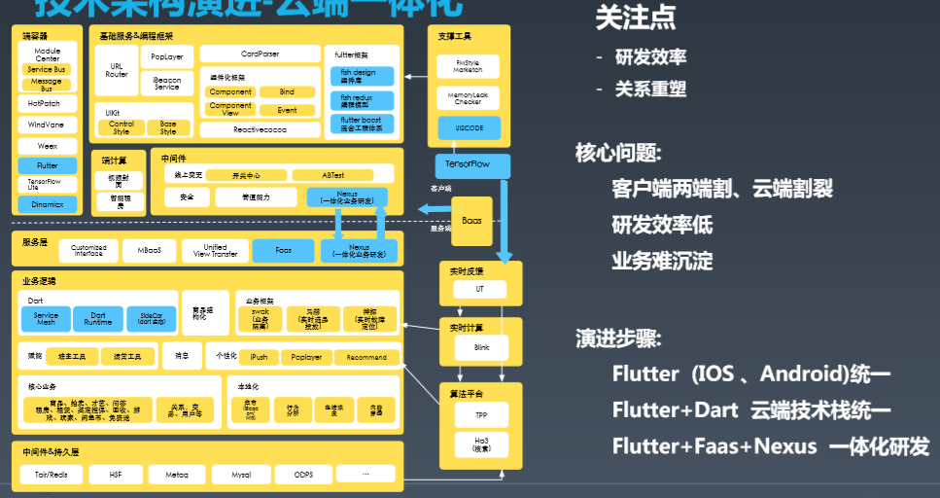
How Architecture Evolution (咸鱼Example)
State 04：“云端一体化”

Slide 10
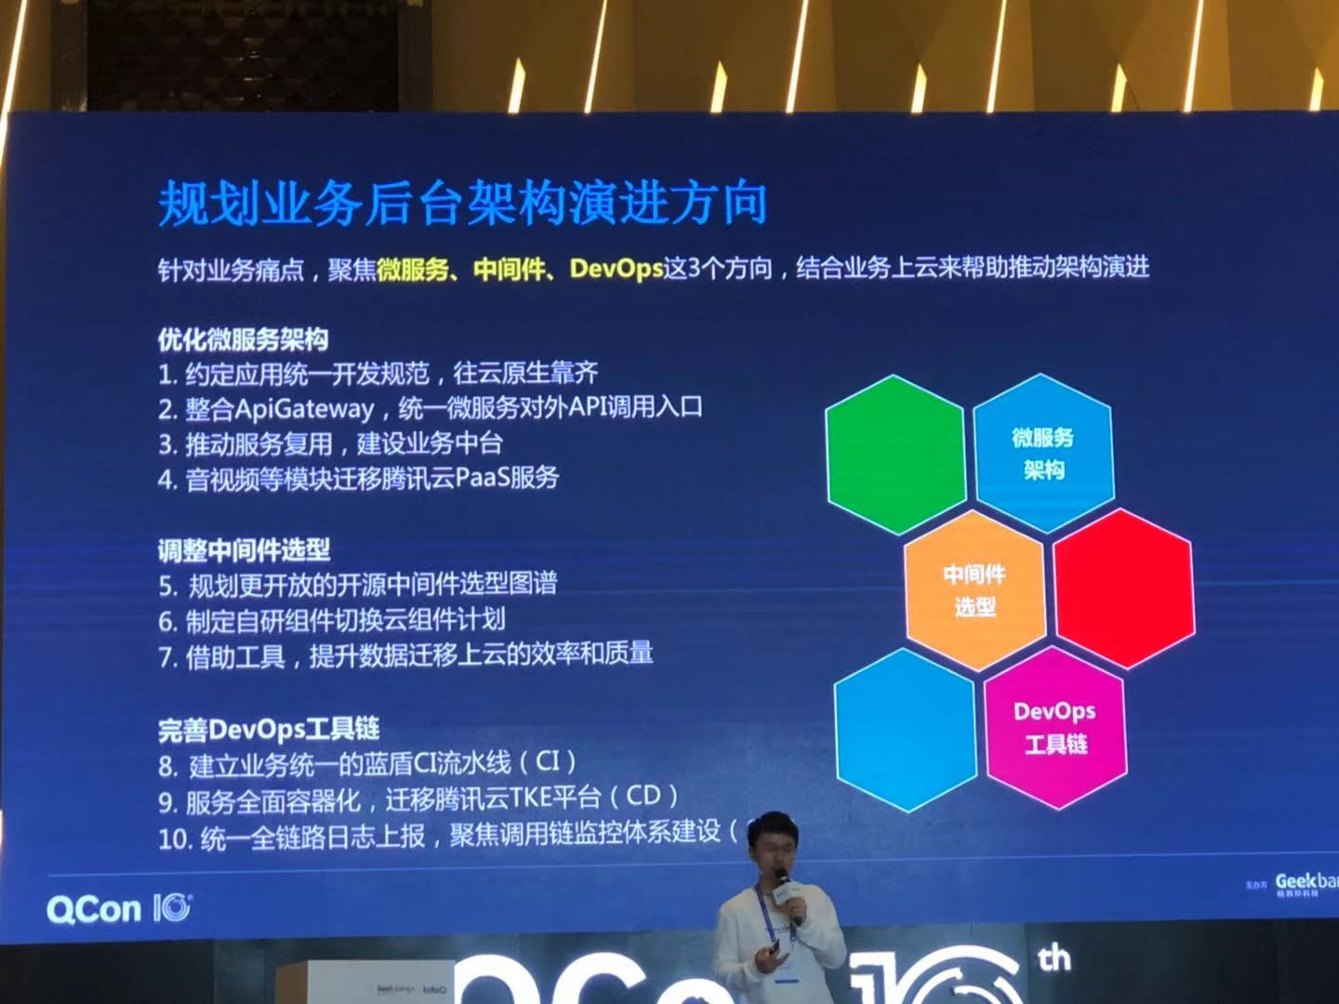
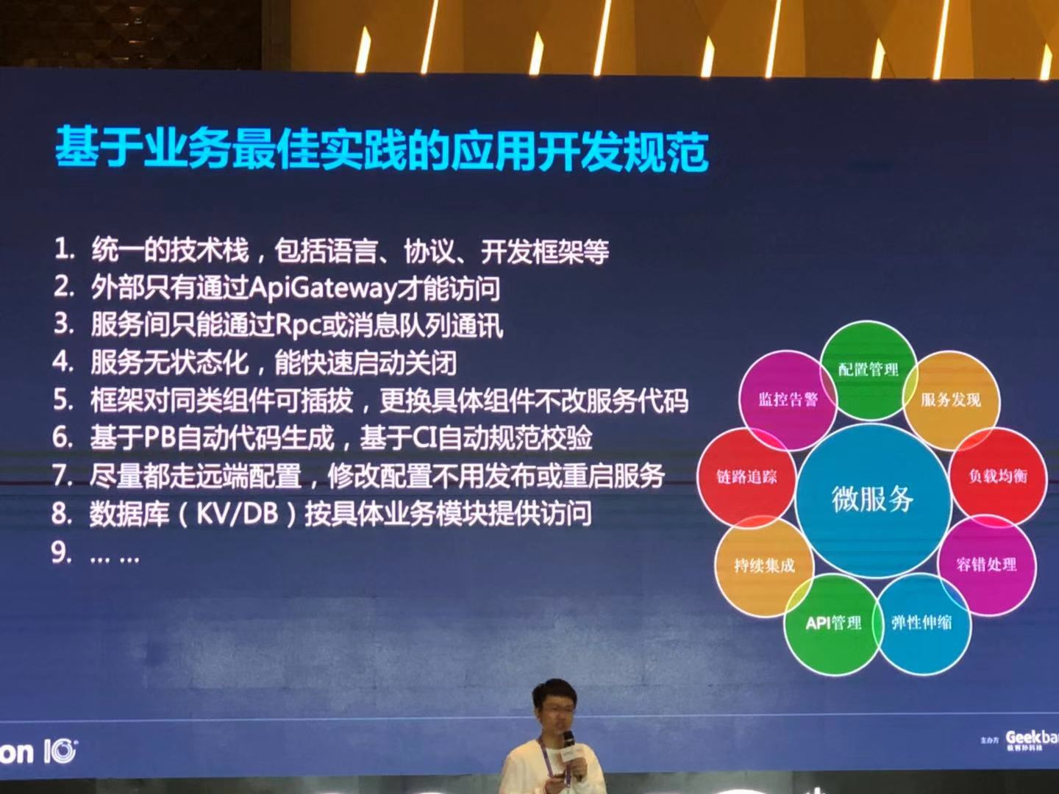
How Architecture Evolution
Consulting industry best practices

Slide 11
Q&A

